Slide 1
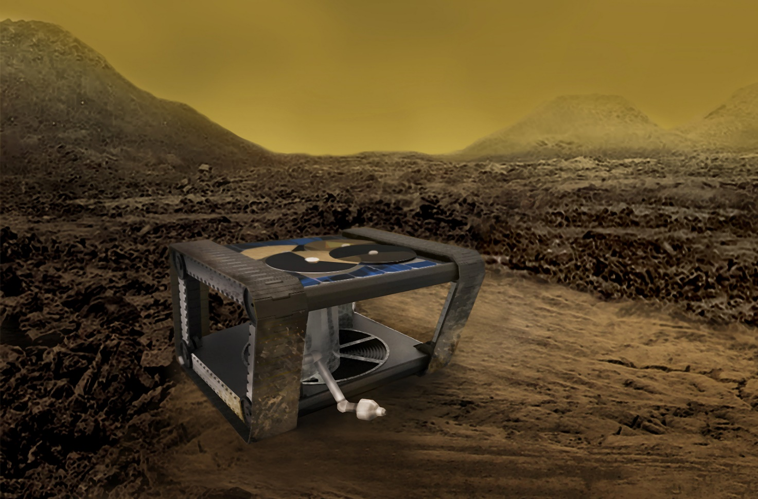
Exploring Venus Together
Group’s name: SAGAN 04
Participants: Calderón, Santino; De Biaggio, Fabrizio and Viarengo, Nicole.
Mission: design an energy storage system that will power a surface lander or rover on the surface of Venus for at least 60 days

Slide 2
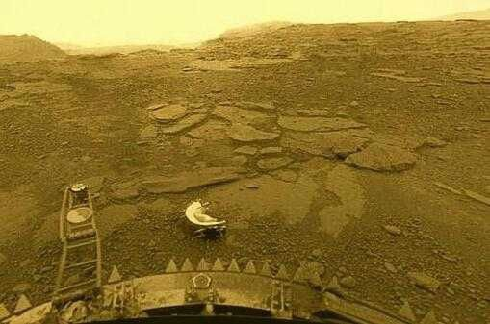
Venus conditions
Venus has a very dense atmosphere composed mainly of carbon dioxide. Its temperature is 460 ° C day and night and its winds are not very strong

Slide 3
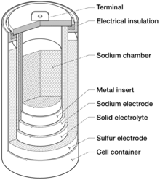
Batteries
Sodium and sulfur batteries are used in this project, which are rechargeable, highly durable, have a high energy density, high charge/discharge efficiency and temperatures of 300 to 350°C make them suitable for stationary energy storage applications.

Slide 4
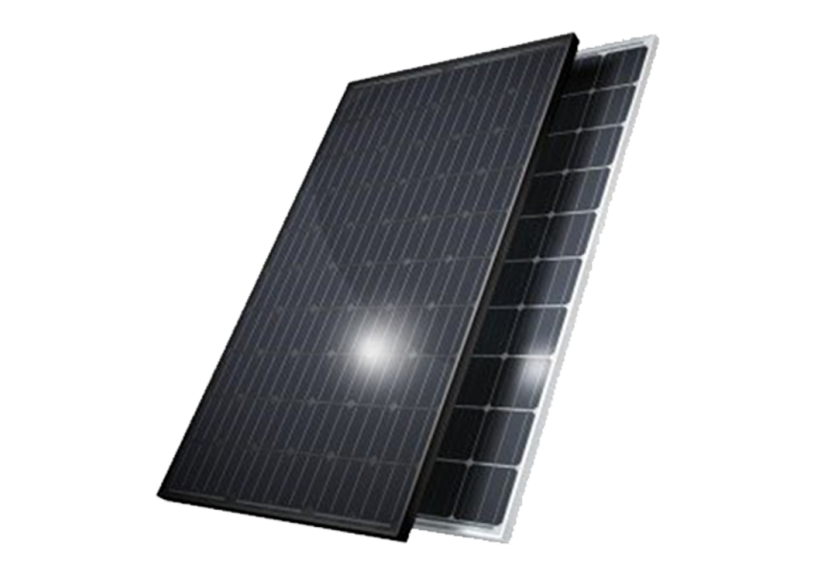
Solar panels
The main power source to recharge the battery is an inverted metamorphic multijunction solar panel. The materials with which it is made allow a broader use within the light spectrum, it also has a wide enough energy gap to work at the high temperatures of Venus.

Slide 5

Vertical Wind Turbine
If the solar panel fails or if the intensity of sunlight decreases due to clouds or if it is night, the battery has a backup recharging system which is a wind turbine. Although the winds are not strong on Venus, the atmosphere is dense enough for the use of the turbine to be efficient.

Slide 6
Stirling Refrigeration System
Since the temperature on the surface of Venus exceeds the operating temperature of the battery, a cooling system will be used. The heat will be pumped out using a Stirling cooler, which works by compressing and expanding a gas with a piston.

Slide 7
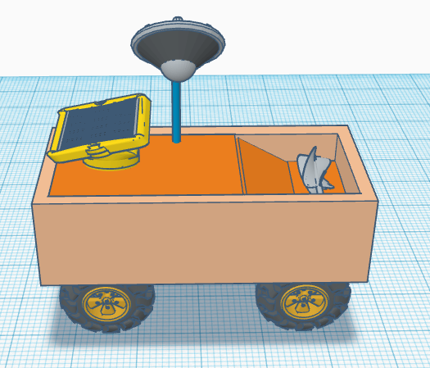
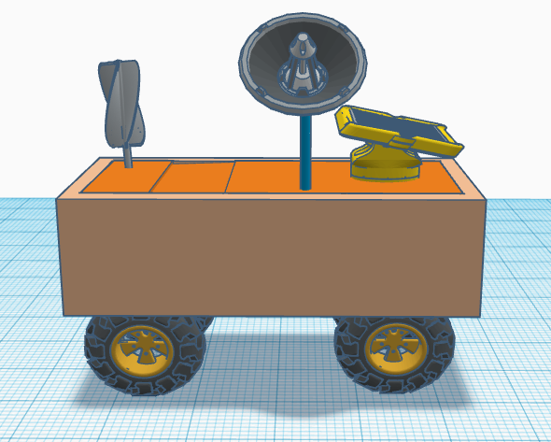
Ilustrative Desing
The images show the configuration of the turbine folded and unfolded.

